Slide 1
United Way of Metropolitan Dallas Welcome Plano ISD 2017 United Way Campaign
Plano ISD does not directly or indirectly require or coerce employees to:
1.) make or not make a contribution to a charitable organization or in response to a fund-raiser; or
2.) attend or not attend a meeting called for the purpose of soliciting charitable contributions.

Slide 2
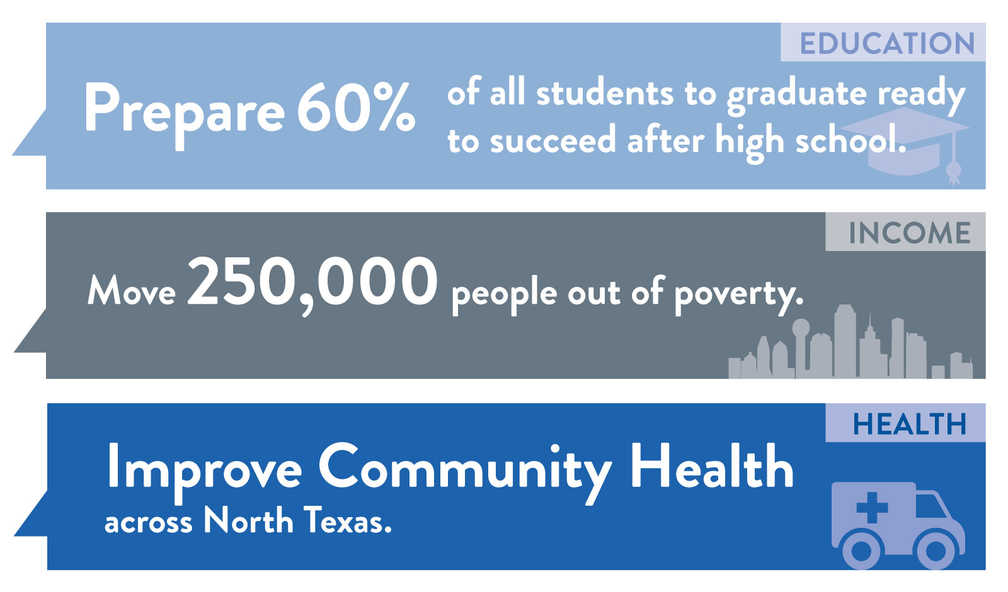
Our Goals / Changing Lives Forever in North Texas
Notes:
United Way of Metropolitan Dallas brings together the power of problem solvers, difference makers, and opportunity creators. Together we are on a mission to change lives forever in Dallas, Collin, Rockwall and southern Denton counties. Our focus is on lasting, generational change therefore our game plan is focused on key areas that require experience and cross section coordination. Our key focus is on expanding educational opportunities, support families struggling in poverty, and improve community health in North Texas.
In 2010, residents of North Texas developed 10 year community goals. But they are more than goals to us; their expectations. And we are committed to doing everything we can to help North Texans reach them.
- Review each community goal

Slide 3
Progress / Education

Slide 4
Need / Education

Slide 5
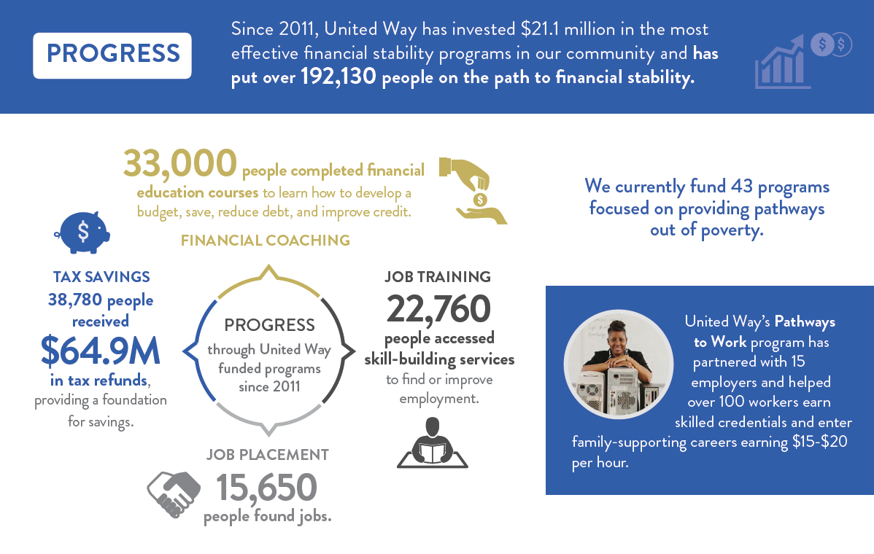
Progress / Income

Slide 6
Need / Income

Slide 7
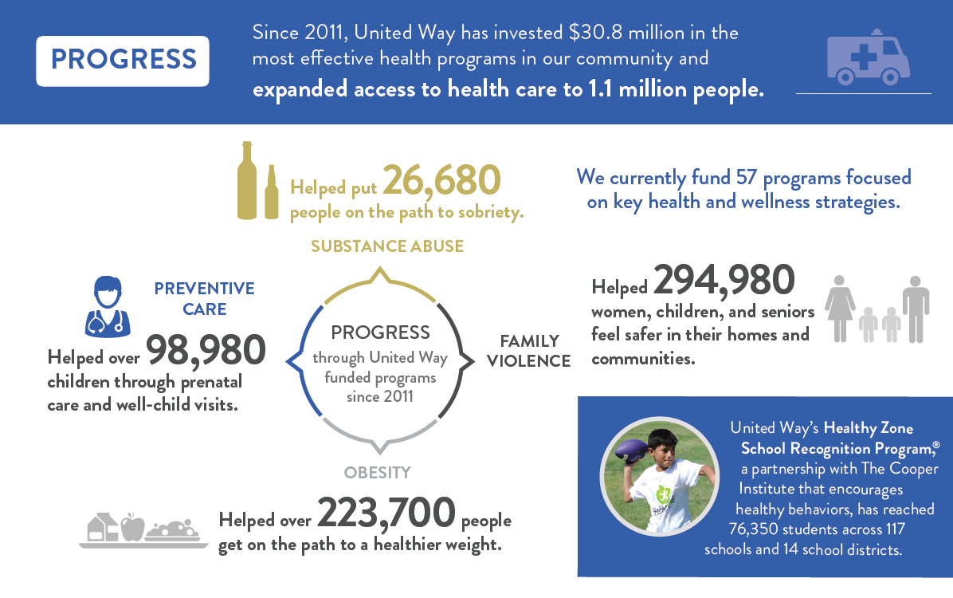
Progress / Health

Slide 8
Need / Health

Slide 9
2017 Campaign Goal
$116,000

Slide 10
Campaign Timeline
Campaign materials delivered to Coordinators by August 25
United Way Campaign Dates September 5-15
Meetings with UW Presentation September 5-15
Return pledge packets to
Communications Department September 27
Notes:
Note to staff: Edit this slide to reflect the campaign information for the specific company

Slide 11
Thank you for investing United Way Plano ISD 2017 United Way Campaign
Plano ISD does not directly or indirectly require or coerce employees to:
1.) make or not make a contribution to a charitable organization or in response to a fund-raiser; or
2.) attend or not attend a meeting called for the purpose of soliciting charitable contributions.

